Slide 1

URBAN MOBILITY CHALLENGE
Alessandro Borgherini - 2123456
Riccardo Rettore - 2110512
Thomas Zamprogno - 2121463

Slide 2
Outline
Introduction & Objectives
Framework
Obstacle avoidance procedure
Trajectory tracking control
State error feedback controller
Linear control
Nonlinear control
Output error feedback controller
B-point control
Further derivatives control
Parking
Cartesian regulation
Posture regulation
Final considerations

Slide 3
Introduction: the "urban mobility challenge"
Problem: An autonomous guided vehicle (AGV) has to travel along a closed circuit avoiding the other AGVs that are parked along the path; at the completion of one lap, the AGV has to get off the circuit and park at the box
PROJECT OBJECTIVES:
Track a closed-loop trajectory
Avoid obstacles on the trajectory
After performing one lap, reach an empty parking lot
PROPOSED SOLUTIONS:
State & output error feedback
Sensor for obstacle detection and avoidance
Cartesian & Posture regulation

Slide 4
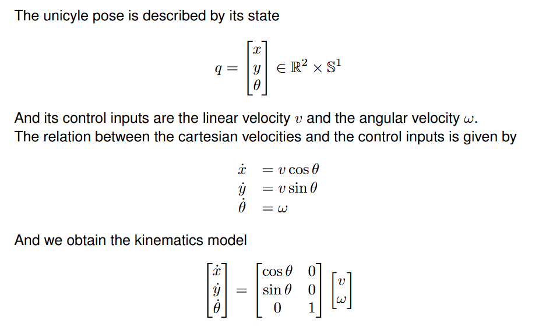
Framework: unicycle
θ
The AGV used in the project is a unicycle robot, a planar vehicle with a single orientable wheel
y
x

Slide 5
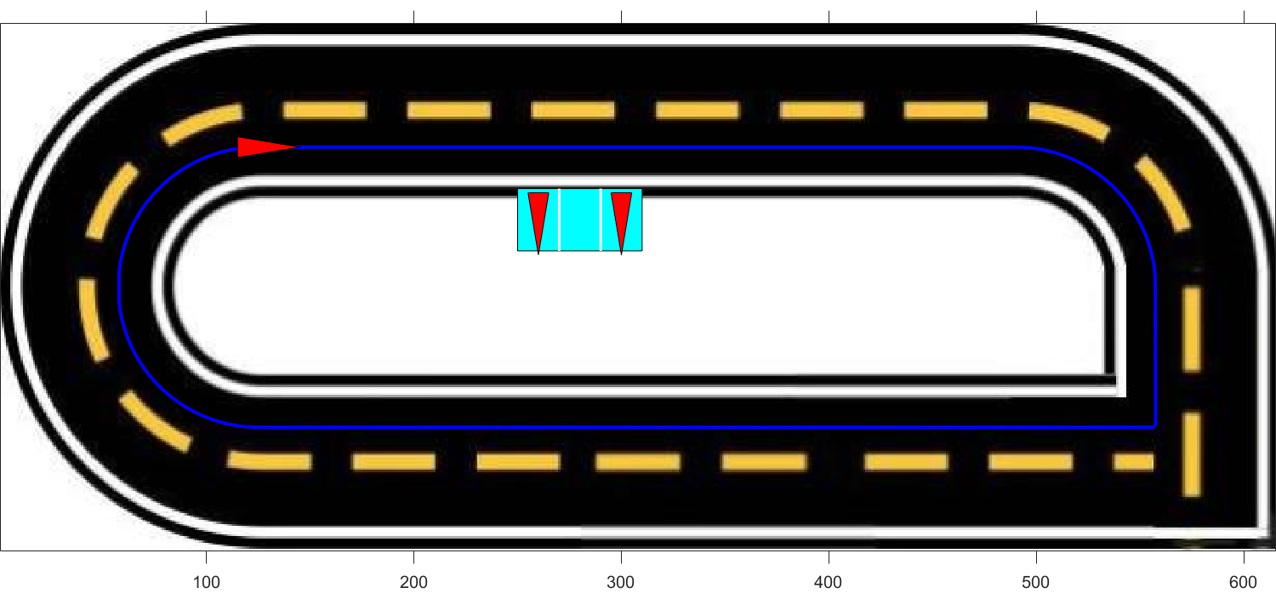
Framework: trajectory
To design the desired trajectory, a series of waypoints was defined. These waypoints were then interpolated using cubic spline interpolation to ensure a continuous path
To test controllers' functionalities on a non-continuous path, a sharp square-angle turn is added to the path

Slide 6
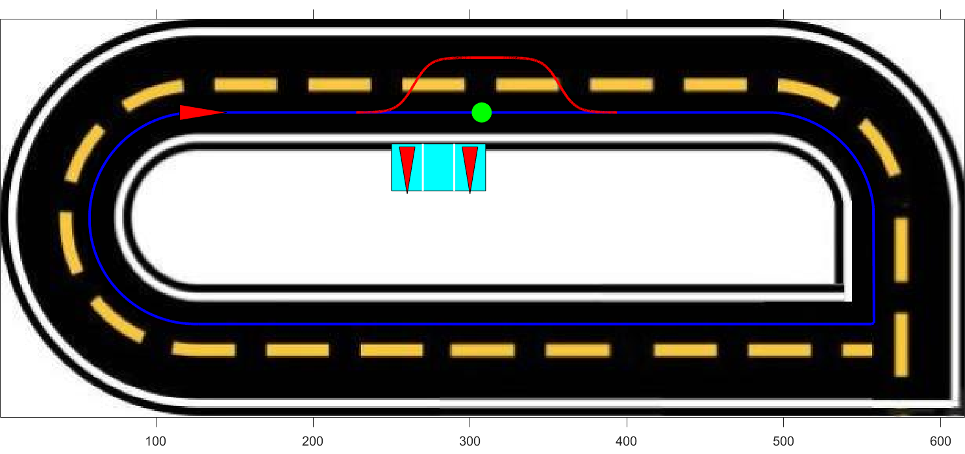
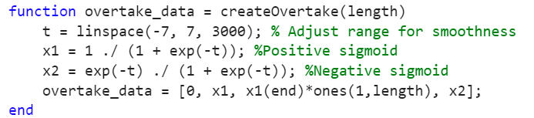
Obstacle avoidance
The unicyle after detecting the obstacle progressively reaches the second lane, after overtaking the obstacle it progressively returns to the first lane
To ensure a smooth and continuous trajectory during the changing lane procedure a sigmoid function has been used

Slide 7
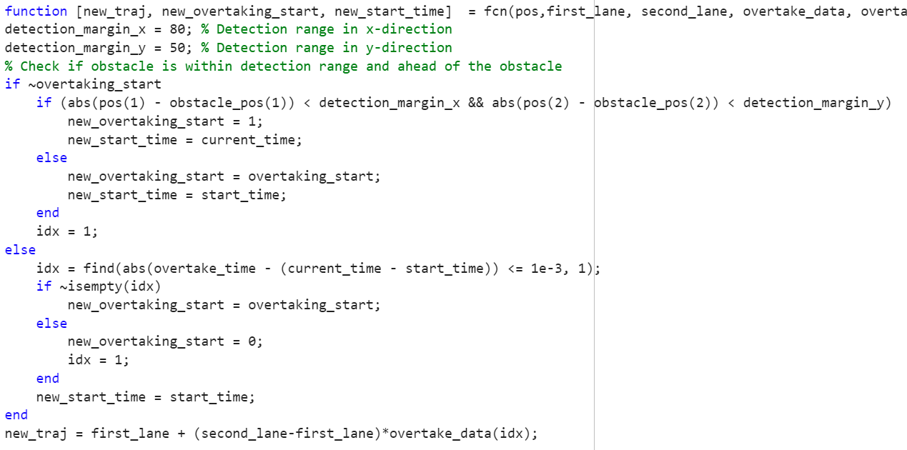
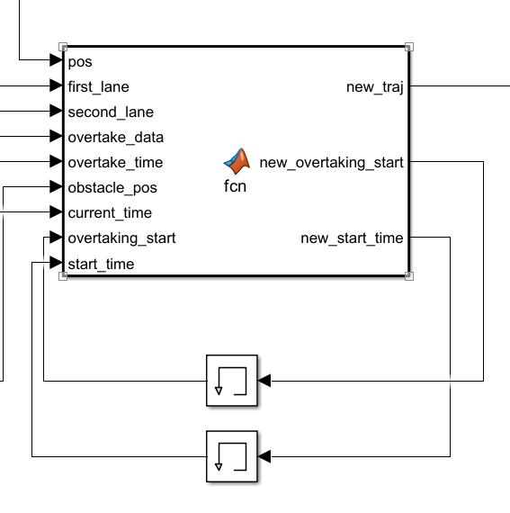
Obstacle avoidance

Slide 8
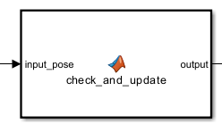
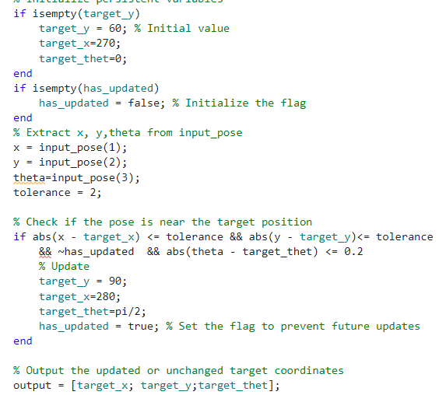
Parking problem
Two waypoints for the parking
Simulate a real parking condition

Slide 9
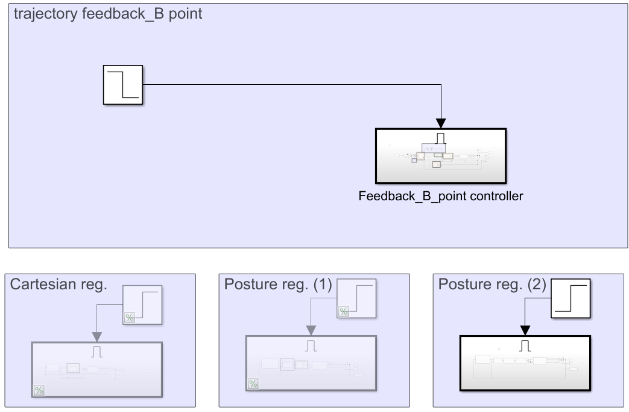
Merger between the tracking trajectory and the parking
Enable to activate individual phases
Automatic switching

Slide 10
TRAJECTORY TRACKING - STATE ERROR FEEDBACK

Slide 11
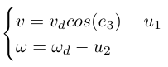
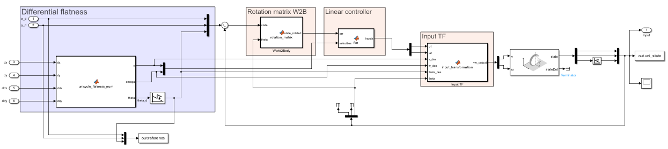
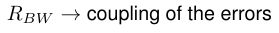
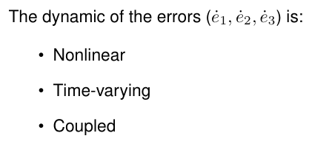
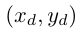
Design
controller
twice differentiable
! Constraints on the trajectory !
and feasible for the unicycle

Slide 12
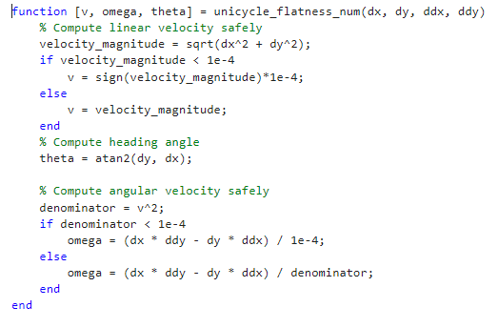
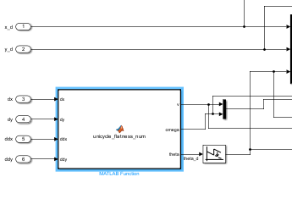
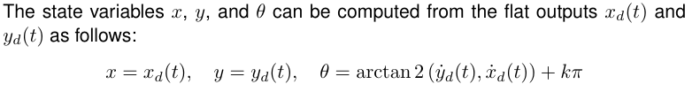
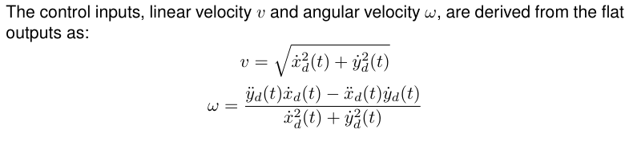
Differential Flatness
avoiding division by zero

Slide 13
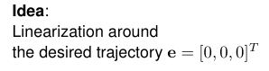
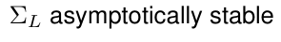
Linear Control

Slide 14
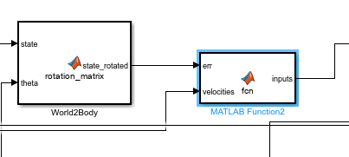
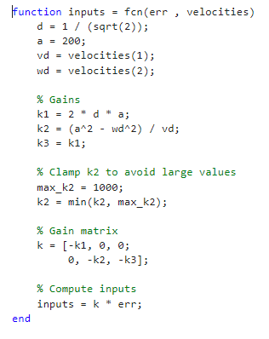
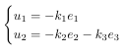
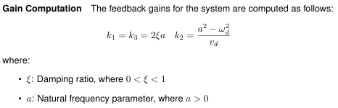
Controller design
saturation
persistent trajectories
TI
TV
no guarantee of asymptotic stability,
only for rectilinear and circular motion
Eigs allocation:

Slide 15
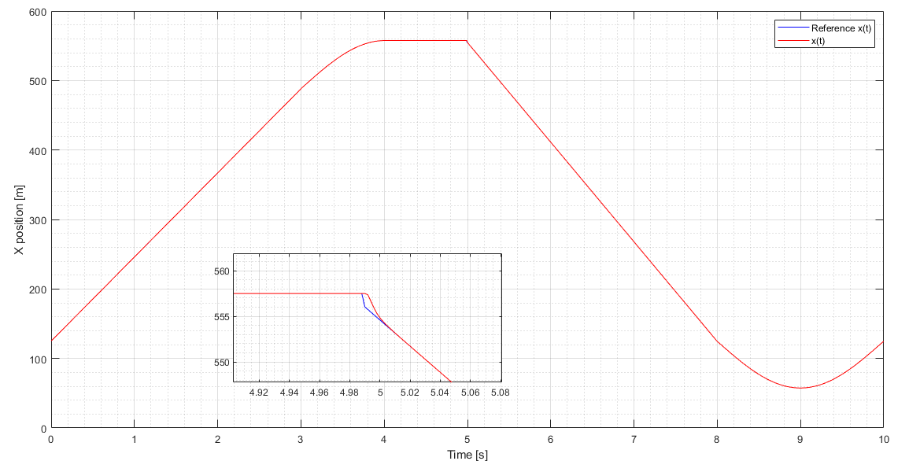
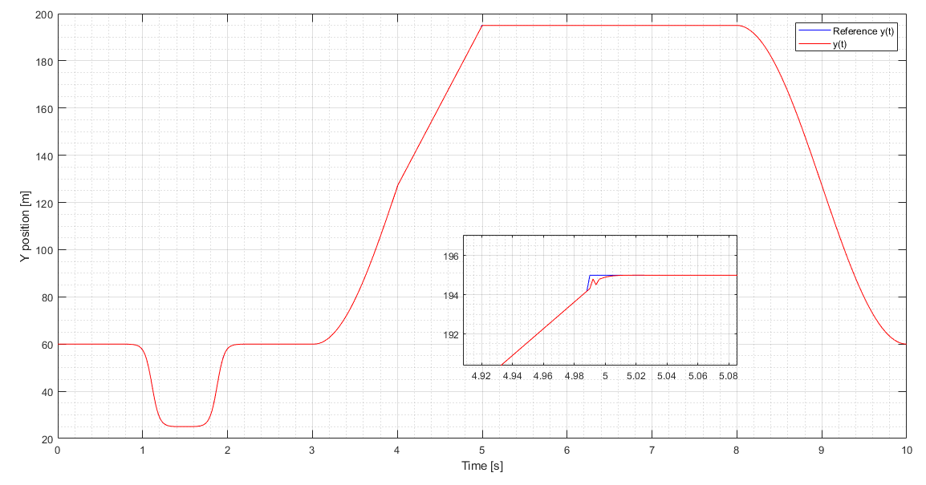
Plots
X TRACKING
Y TRACKING

Slide 16
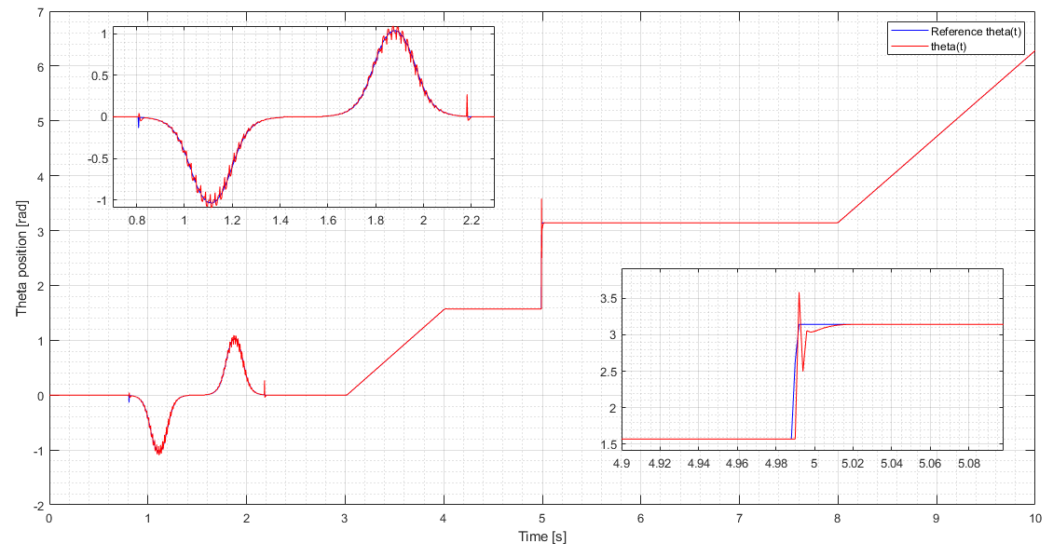

Slide 17
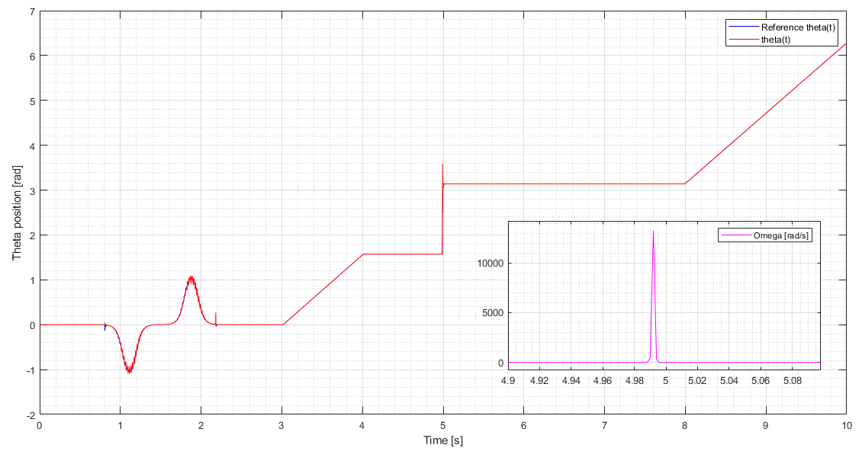
FOCUS ON SQUARE CORNER

Slide 18
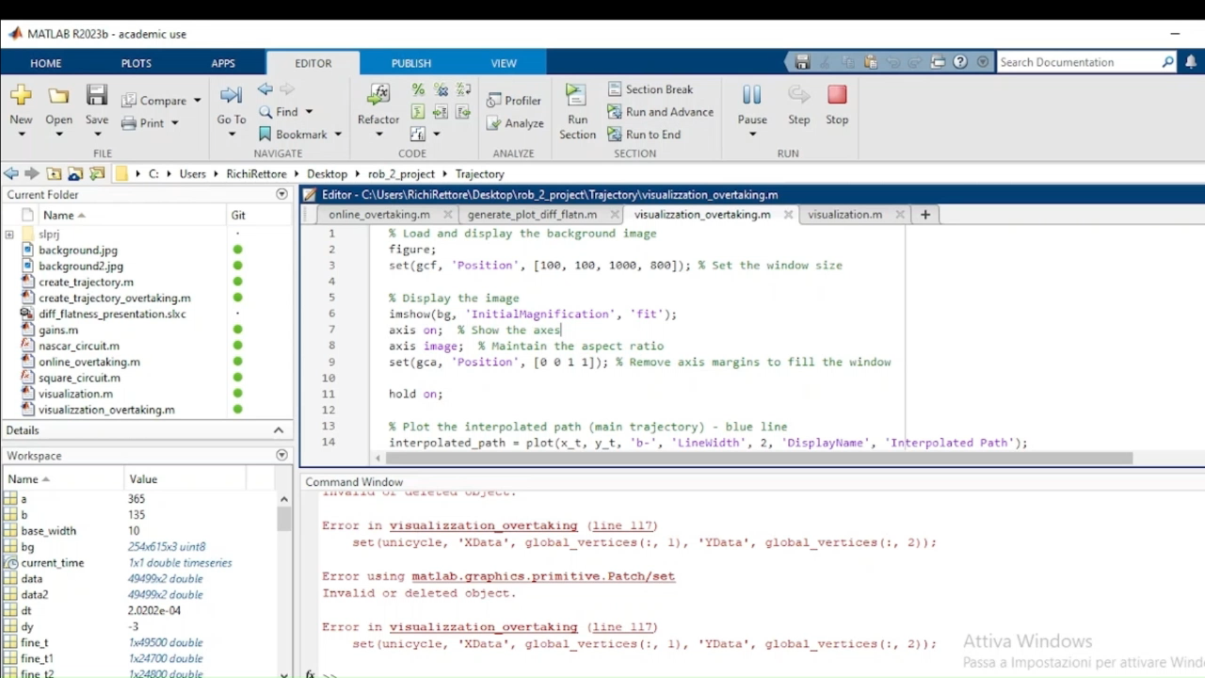

Slide 19
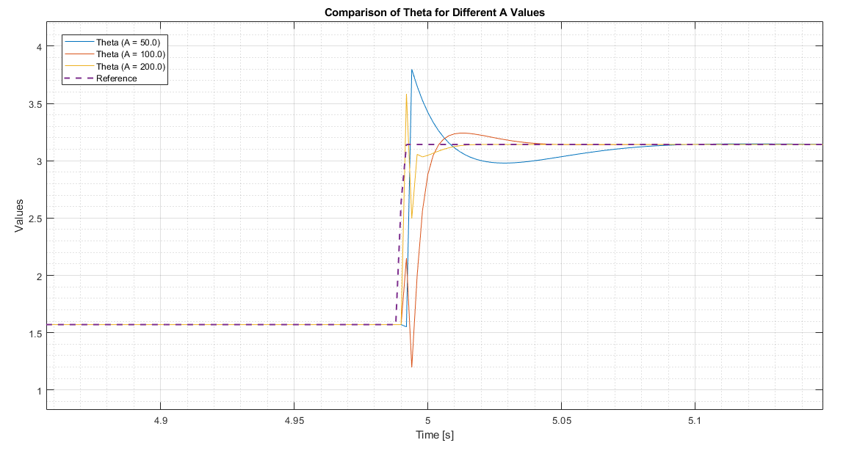

Slide 20
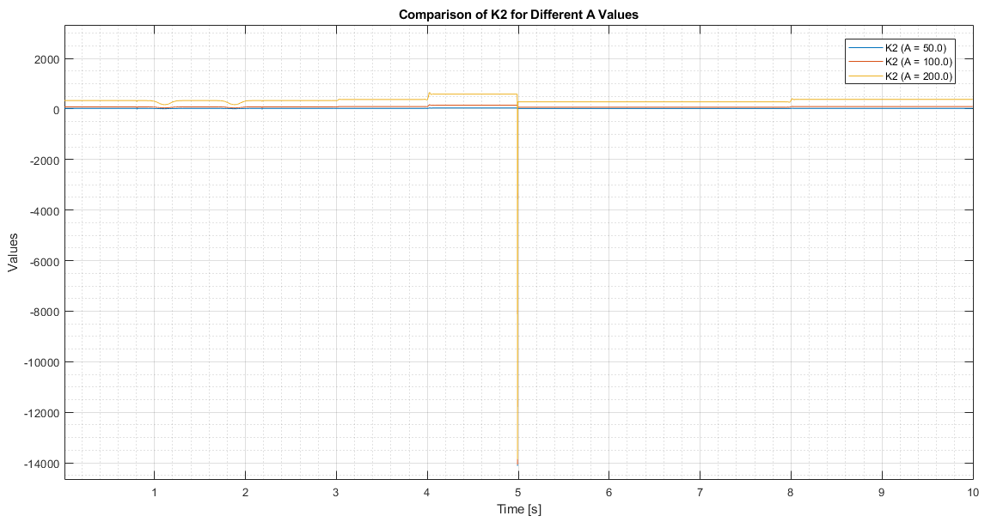
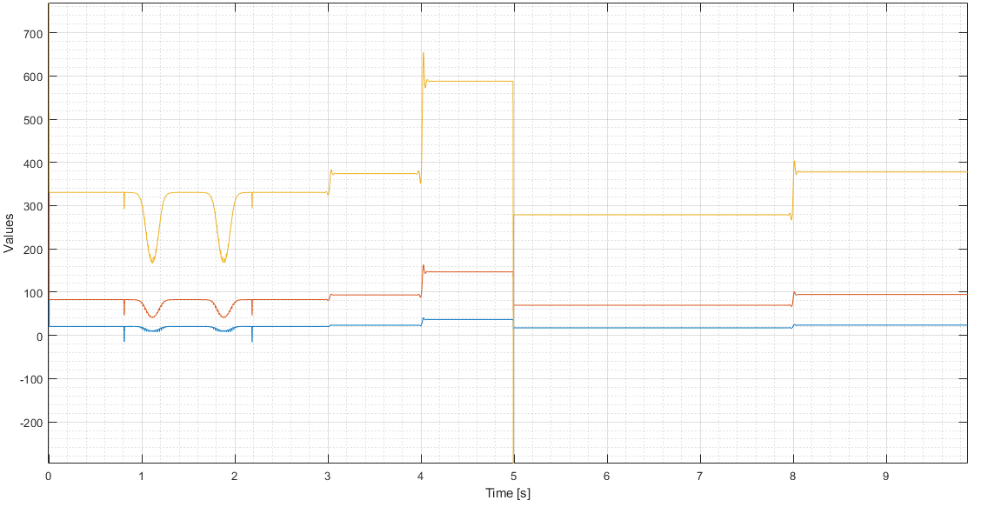
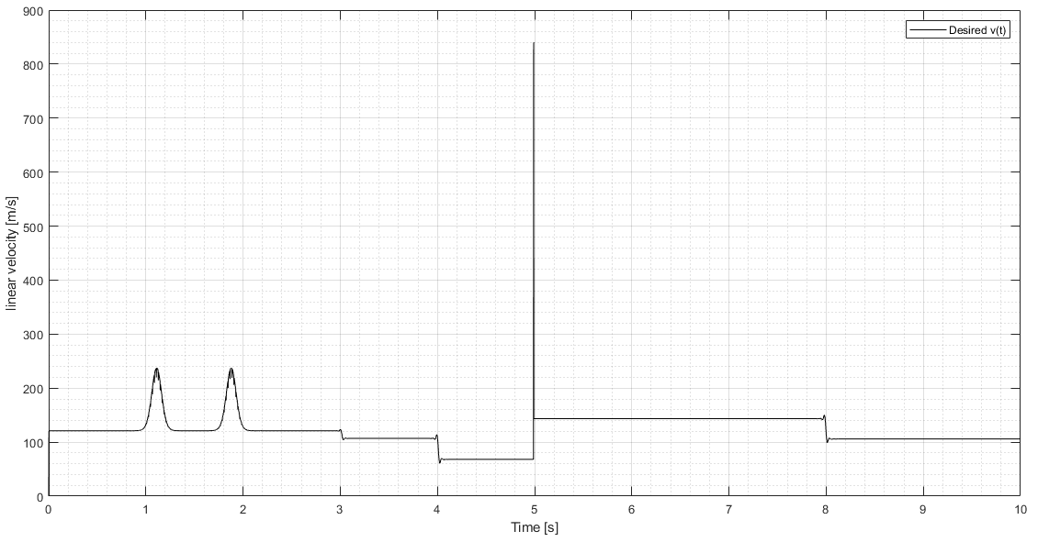
Vd(t)

Slide 21
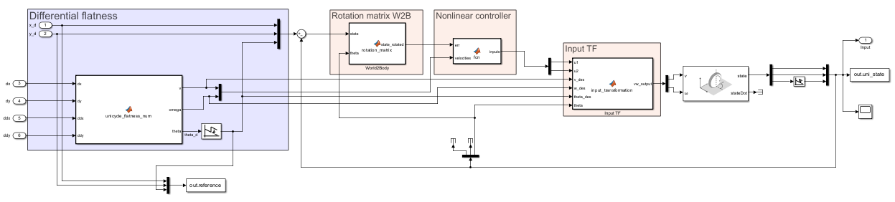
Nonlinear Control
dynamic of the errors is in mixed form

Slide 22
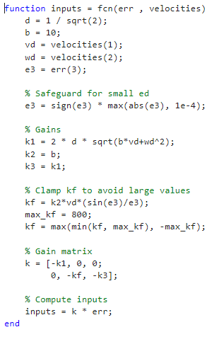
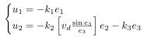
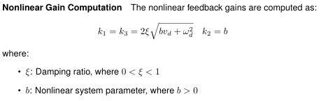
Controller design
nonlinear term
no more singularity in vd=0
TV
TI
resembles k2 of the linear controller
square curve
global asymptotic stability
assuming (vd,wd) bounded with bounded derivatives
and (vd,wd) do not go concurrently to zero

Slide 23
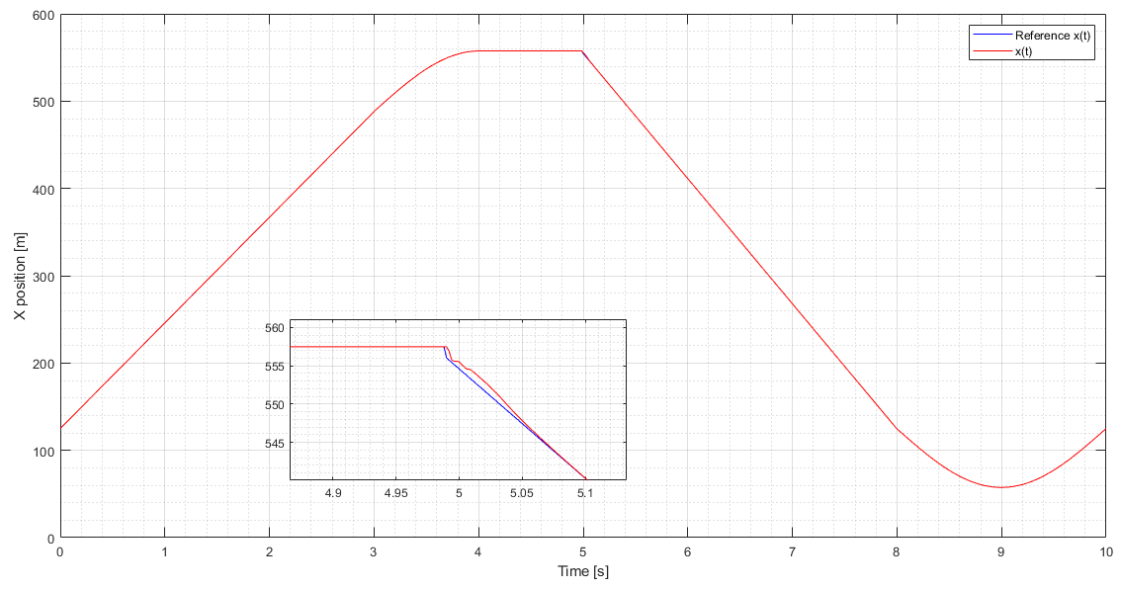
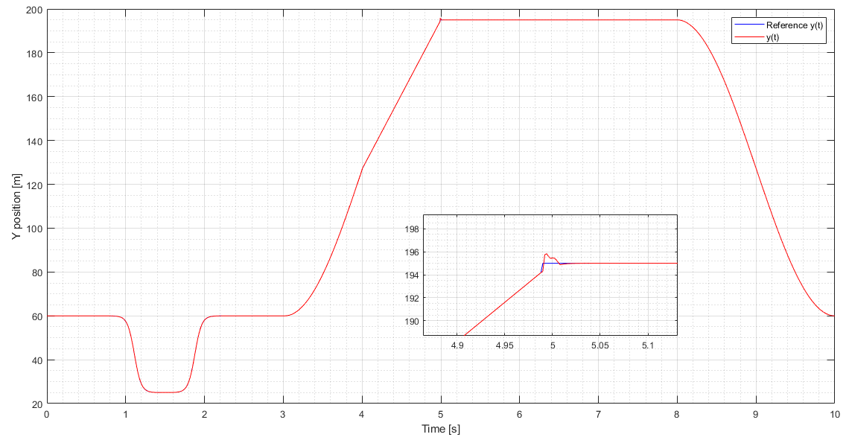
Plots
X TRACKING
Y TRACKING

Slide 24
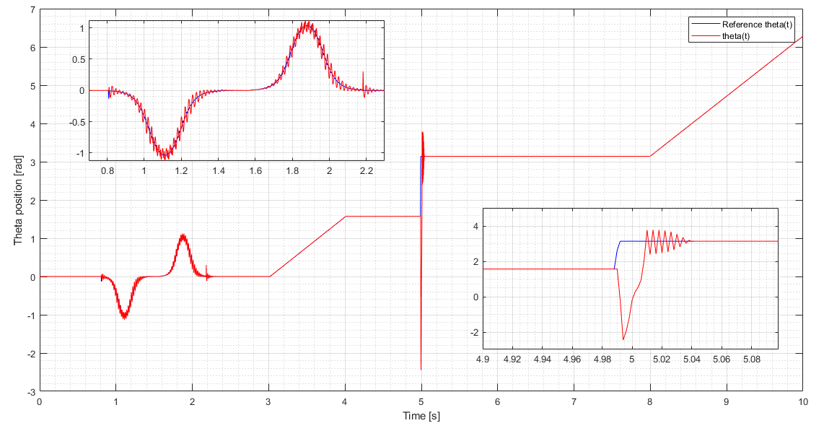

Slide 25
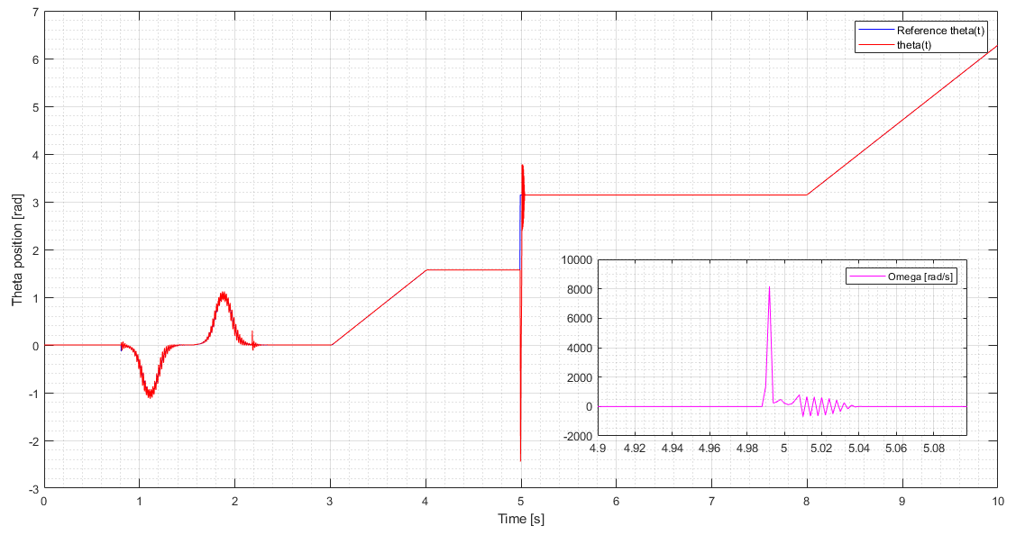
FOCUS ON SQUARE CORNER

Slide 26
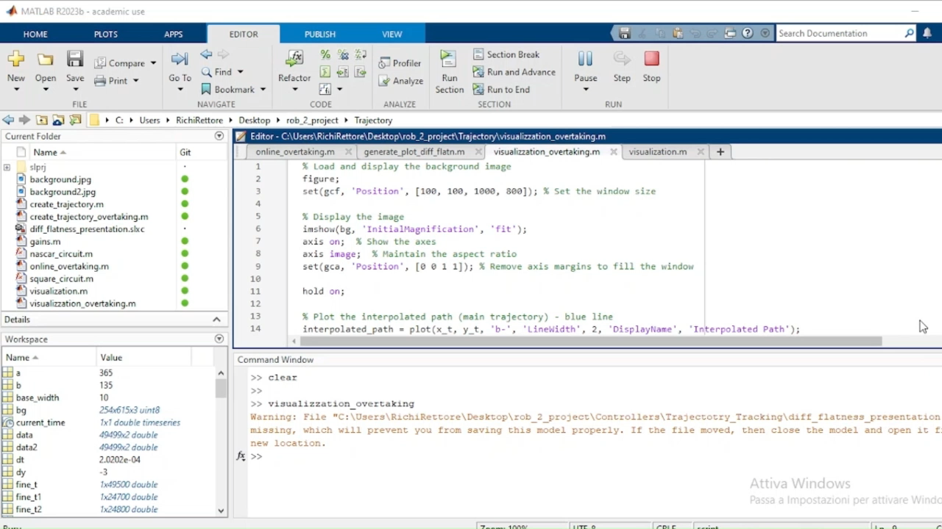

Slide 27
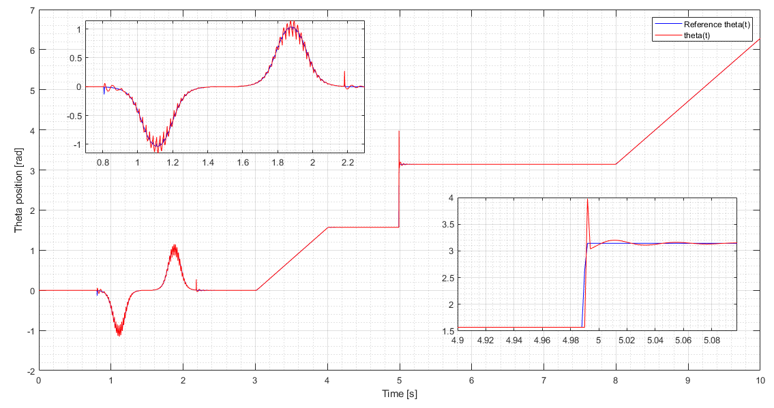
changing desired dumping and b:
d = 2 / sqrt(2)
b =1
Less aggressive , more stable

Slide 28
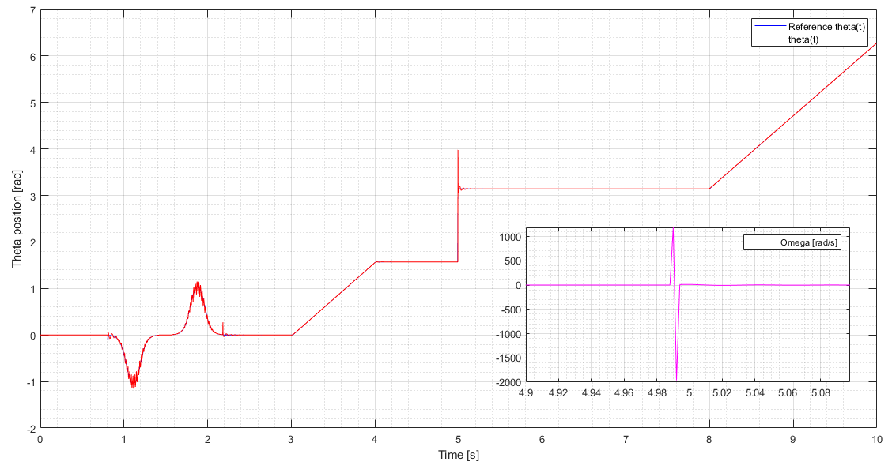
d = 2 / sqrt(2)
b =1

Slide 29
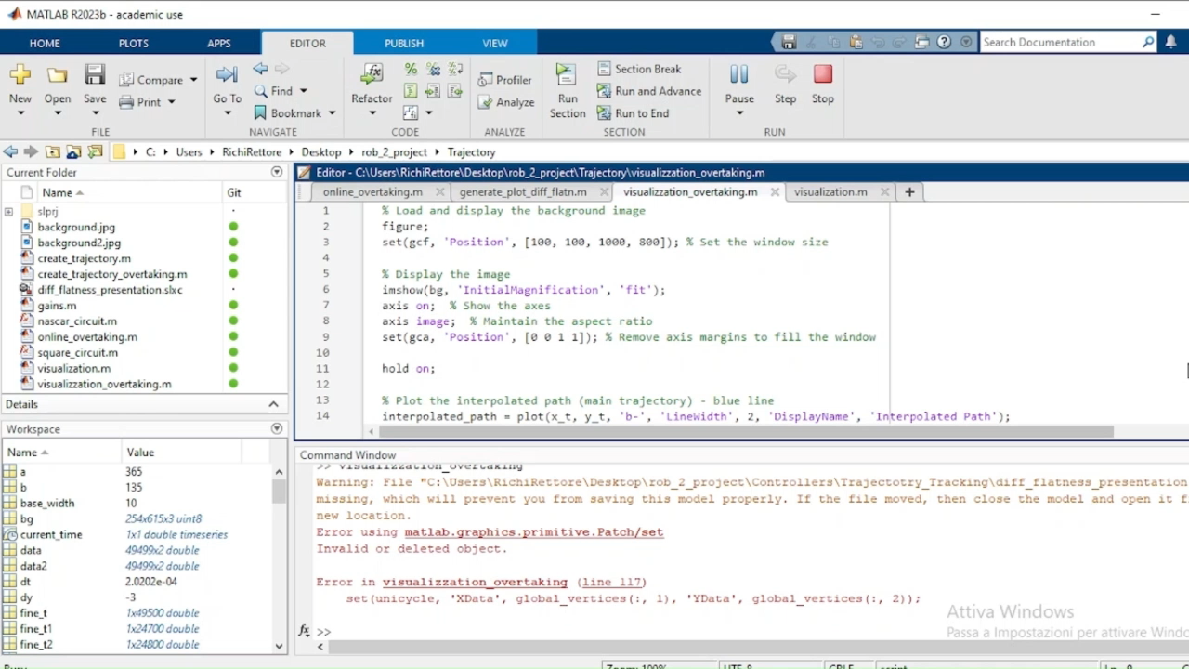

Slide 30
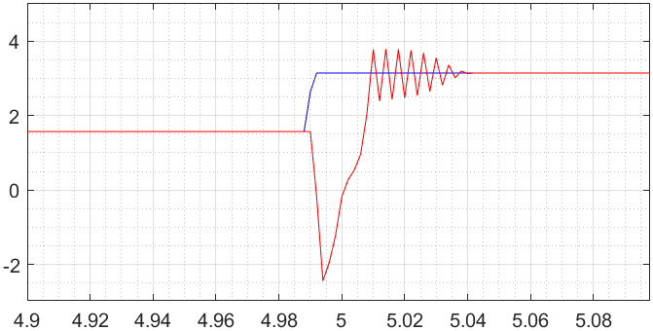
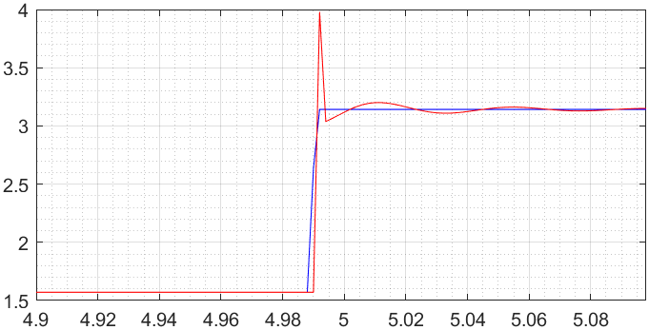
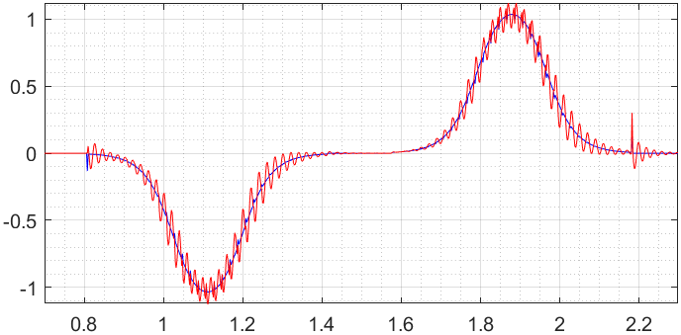
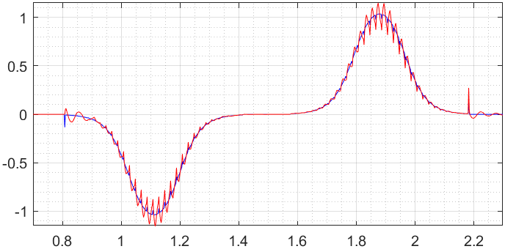
d = 1 / sqrt(2)
b =10
d = 2 / sqrt(2)
b =1
d = 1 / sqrt(2)
b =10
d = 2 / sqrt(2)
b =1

Slide 31
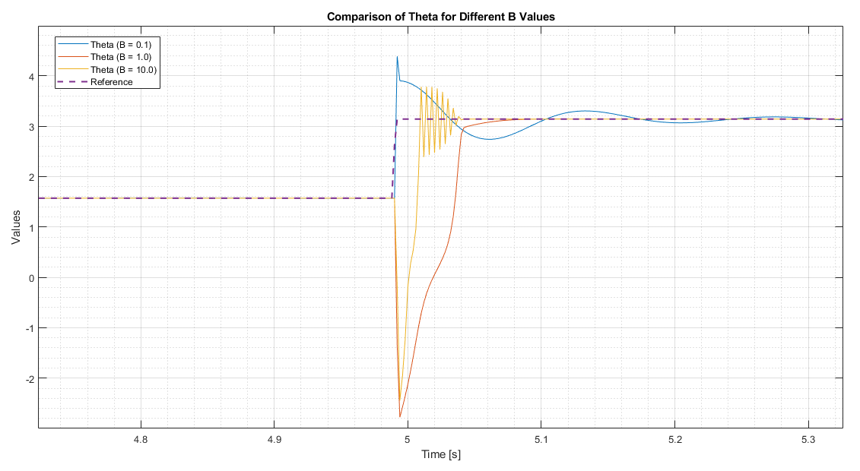
d = 1 / sqrt(2)

Slide 32


d = 1 / sqrt(2)
Vd(t)

Slide 33
TRAJECTORY TRACKING - OUTPUT ERROR FEEDBACK

Slide 34



Feedback linearization based on a reference point on the sagittal axis

Slide 35





Map

Slide 36





Controller design
Pro:

Slide 37


Plot

Slide 38



Slide 39

Plot
b small:
Better trajectory
b large:
A smoother trajectory

Slide 40

Plot
b small:
Higher rotational speed
b large:
Less rotational speed

Slide 41


Slide 42



Feedback linearization based on second order derivatives

Slide 43




Map
It prevents singularity due to the angle at 90° with v=0

Slide 44






Controller design
PD
Need:

Slide 45


Plot

Slide 46



Plot

Slide 47


Slide 48
REGULATION

Slide 49


Cartesian regulation

Slide 50




Control law
$$γ$$

Slide 51

Plot
Proportional trend
The greater the error, the greater the speed action
The error tends to zero, resulting in lower speed

Slide 52


Plot
Overshoot 1.79%

Slide 53


Gains
Overshoot [2, 1.5, 1.2] %
Final position in [0.15, 0.25, 0.45] s

Slide 54


Slide 55


Posture regulation (1° version)
Convert to polar coordinates

Slide 56




State trasformation
polar coordinates

Slide 57





Control law
New term
Problem:potential singularity when ρ=0
At starting time $γ$ is 0

Slide 58


Plot
Final position in [0.35, 0.4, 0.6] s

Slide 59



Plot
Lenght from the origin
!

Slide 60

Plot
V is modulated based on the distance from the origin
High speed far from the origin
Greater precision with lower speed when close to the origin.

Slide 61

Posture regulation(with singularity)

Slide 62


Posture regulation (2°version)
New:
Avoid singularity on ρ with change of input

Slide 63



New Control law

Slide 64


Final position in [0.5, 0.7, 1.6] s
The concave shape is given by the fact that the linear velocity is proportional to roh
Plot

Slide 65

Posture regulation (without singularity)

Slide 66
Final considerations - tracking
BEST AMONG THE FOUR
State error feedback
Works with the state (x,y,theta) → theta directly controlled
Trajectory must be twice differentiable and persistent
Differential Flatness block induces constraints on the trajectory
System dynamic is coupled
Controller design is more complicated than the others, gains are time varying and related to the velocities
Convergence is difficult to guarantee (linear → only locally, nonlinear → only with bounded velocities and bounded derivatives)
Output error feedback , B-point
Theta is not directly controlled, but coupled in the dynamics with x and y
It works with any trajectories, given in terms of xb and yb, so no smooth constraints (as far as b!=0)
The dynamic becomes linear,decoupled, SISO , single integrator
Control design is easy, PD with gains TI and > 0
Output error feedback , further derivatives
Same as diff flatn, trajectory must be smooth (differentiable) and persistent , v!=0 (singular mapping)
System dynamic becomes decoupled, linear, double integrator
Controller design is quite easy, gains TI and >0 (but there are 4 gains)

Slide 67
Final considerations - regulation
Cartesian regulation
Theta non controlled
v proportional to ep
Controller design simple, 2 gains > 0
No singularities issues
Posture regulation
Theta is now controlled but indirectly (through gamma and delta)
Controller design is more difficult, 3 gains and gamma at the denom (even if there is semplification in case)
Singularity problem in rho=0 → solved by shifting singularity in input

Slide 68

Output error feedback (B-point) and posture regulation(without singularity)

